Slide 1


Getting Started with AI for Spatial Data
Zifu Wang and Devika Jain
Center for Geographic Analysis, Harvard University

Slide 2
Chapter 1
Introduction
Getting Started with AI for Spatial Data

Slide 3
Who we are
Zifu Wang
  Postdoctoral Research Fellow
Devika Kakkar
  Data Science Project Manager

Slide 4
Who are you?
Short round of introduction
  Name & field of research
  Why are you here? What do you hope to take away from this workshop? What do you want to use AI for?
Warm up
  Have you worked with the LLM before?
  How do you rate your own programming experience level?
Notes:
Corners:
Have you worked with the FASRC before?
The command line?
Line: How do you rate your own programming experience level?

Slide 5
Agenda
Five chapters
  Introduction
  Case Study & Data Sets
  Location Extraction by LLM
  Image Interpretation by LLM
  Questions & Comments?
Input
Hands on

Slide 6
Files & Data for the Workshop
Files and Software
  Slides, exercises, command cheat sheet, and code files
  GitHub: https://github.com/wangfarmer/cga_workshop
  LM Studio: https://lmstudio.ai/
Datasets
  All data we’ll work with
  Publicly accessible on the github: https://github.com/wangfarmer/cga_workshop/tree/main/Data

Slide 7
What is Spatial Data
Most people think:
  Coordinates
  Shapefiles
  Maps
But today spatial information also exists in:
  📰 News articles
  📱 Social media
  🛰 Satellite images
  🚗 Street view images

Slide 8
The Challenge
Unstructured data:
  Text is messy
  Images are visual
  No predefined columns
  No explicit coordinates
Traditional GIS:
  Requires structured attributes
  Cannot directly interpret language or visual context
  How do we convert unstructured data into structured spatial information?

Slide 9
Introduction to AI
What is Artificial Intelligence
  Systems that learn patterns from data to understand, predict, or generate information
Why AI for Spatial Data
  Understand language
  Interpret images
  Extract structured information
In this workshop, AI helps us:
  Extract buyer & seller countries of illegal trade from news text
  Compare street scenes and reason about spatial qualities

Slide 10
What We’ll Do Today
Use AI to extract spatial relationships from text
→ Build structured country-to-country trade data
Use AI to analyze street-view images
→ Predict spatial perception (e.g., safer, livelier)
Evaluate results (accuracy, validation)

Slide 11
Why This Matters
Because:
  Text contains hidden geographic relationships
  Images contain visual spatial signals
  AI lets us scale analysis across hundreds or thousands of cases
Without AI:
  Manual coding = slow
  Visual inspection = subjective
  Hard to scale
With AI:
  Automated extraction
  Structured output (CSV ready for GIS)
  Reproducible workflow

Slide 12
Chapter 2
Case Study & Data Sets
Getting Started with AI for Spatial Data

Slide 13
Case Study 1 — AI for Illegal Transnational Kidney Trade Extraction
Illicit kidney trade networks operate across countries involving buyers, sellers, brokers, and surgeons.
Understanding global patterns requires extracting geographic locations and roles from news articles — a task that is time-consuming and labor intensive when done manually.
AI can turn unstructured text into structured spatial data:
  Identify countries involved
  Assign roles (seller, buyer)
  Build datasets for spatial network analysis
  Support policy, public health and enforcement research
Wang, Z., Li, M.H., Baxter, P., Zhorayev, O., Wei, J., Kovacs, V., Zhao, Q., Yang, C. and Koizumi, N., 2025. Implementing large language model and retrieval augmented generation to extract geographic locations of illicit transnational kidney trade. International Journal of Health Geographics, 24(1), p.10.
Notes:
SLURM – Simple Linux Utility for Resource Management
Command:
srun –pty: Request an interactive session
-p test: the compute node should be of the test-class
--mem 100: request 100MB of memory
-t 0-1:00: request the session for one hour

Slide 14
Dataset & Scope
Source: News articles about illicit kidney trade (2000–2022) from LexisNexis (https://github.com/wangfarmer/cga_workshop/blob/main/Data/Illegal_Trade_News_Article.csv)
Content: Narrative text describing events
Targets:
  Country where seller is located
  Country where buyer is located

Slide 15
Case Study 2 — Human vs AI Perception of Urban Environments Perception
Research Question
How closely do Large Language Models (LLMs) align with human perception of urban environments?
This study benchmarks AI perception against human judgments using street view imagery

Slide 16
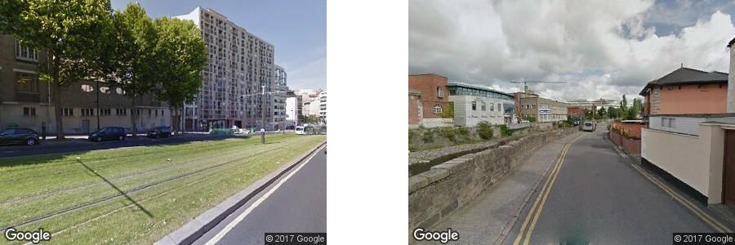
Dataset & Scope
Ground truth data (MIT Place Pulse 2.0):
  110,000+ street view images
  56 cities worldwide
  1+ million human pairwise judgments
Participants answered, Which image looks more:
  Beautiful
  Safe
  Livable
  Wealthy
  Boring
  Depressive

Slide 17
What the AI Had to Do
For each image pair:
  Choose left or right
  Provide reasoning
  Compare with human ground truth

Slide 18
Chapter 3
Location Extraction by LLM (Live Demo)
Getting Started with AI for Spatial Data

Slide 19
Chapter 4
Image Interpretation by LLM (Live Demo)
Getting Started with AI for Spatial Data

Slide 20
Chapter 5
Questions & Comments?
Thank you for joining us!

